Slide 1

INTERNATIONAL POLI CE ASSOCIATION
Andy Sullivan & Steve Bretherton

Slide 2
What is the IPA?
Founded in 1950 by Sgt. Arthur Troop in Lincolnshire.
The IPA is a worldwide friendship organisation.
Open to serving and retired police officers, Specials and staff.
Encourages professional and social links between serving and retired police officers, specials and police staff from around the world.
The IPA network spans 69 countries with over 365,000 members.
Section UK has 7,500 members in 11 Regions and over 50 Branches spread across the country.
Cambridgeshire Branch covers the same geographic area as the Constabulary.
One of the most active branches in the country.

Slide 3
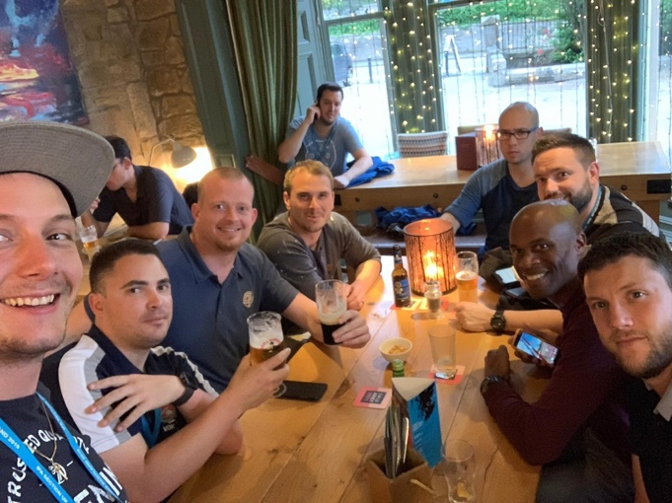
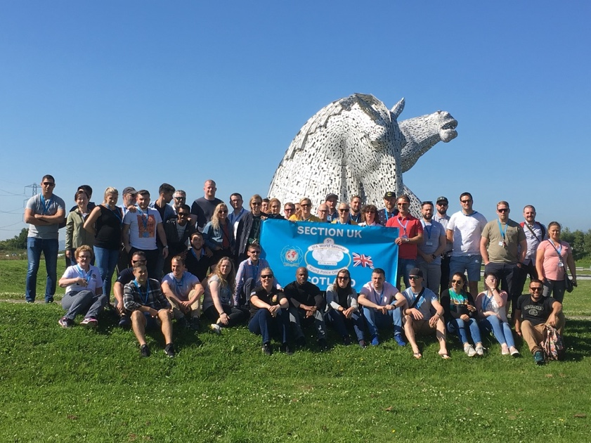
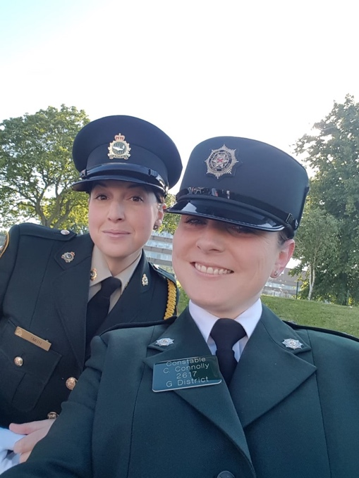
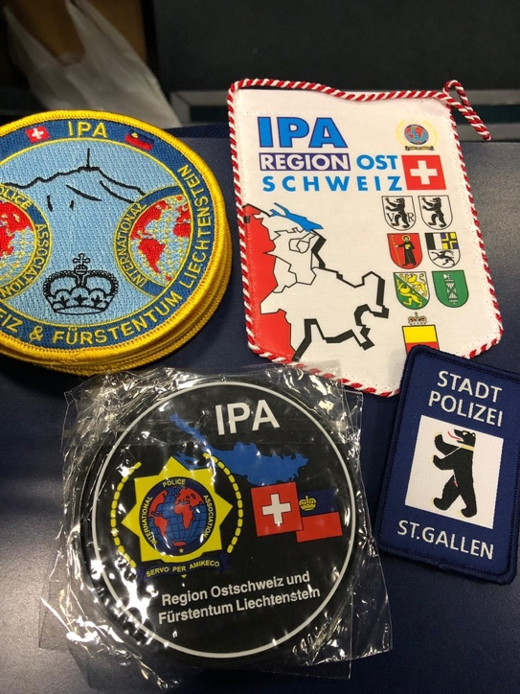
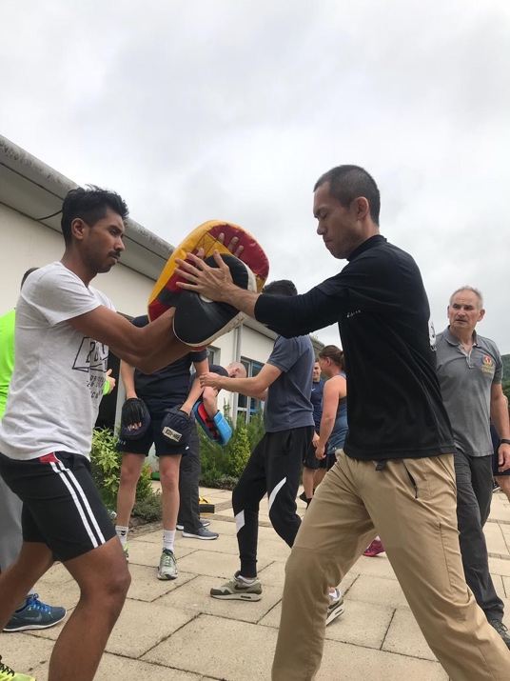
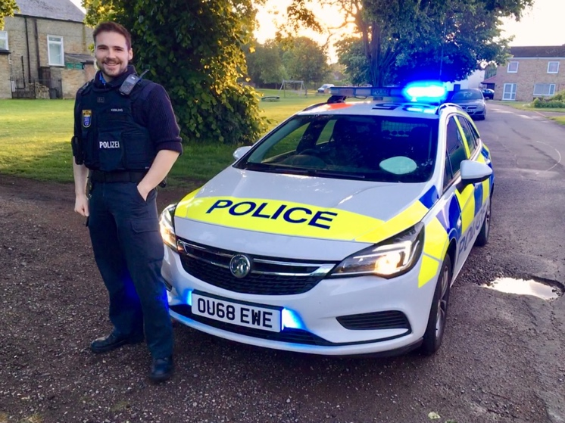
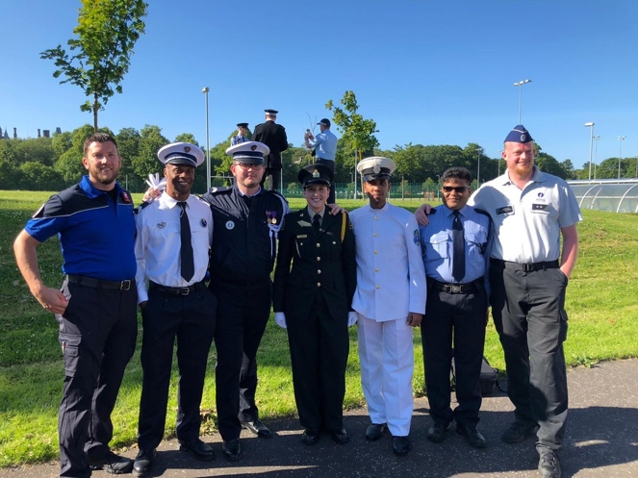
Experience a World of Opportunity

Slide 4
What’s in it for me?
Local, National and International Events
Travel Opportunities
IPA Houses around the World – from around £30
Membership for your Whole Family
Special Interest Groups
Continuous Personal Development
Travel Bursaries
International Networking
Lifelong Friendships Based on Shared Values and Experiences

Slide 5


IPA Houses
There are 40 IPA Houses around the world including:
Gold Coast Apartment, Australia
IPA House in Finland above the Artic circle with 2 saunas
Lisbon IPA HQ – great for groups as well as Porto, Faro & Madeira
Closer to home, there are 6 IPA houses in Ireland inc. Dublin, Cork, Galway
Generally around £30 per night per person.
Hosting book sent to all members every 3 months.

Slide 6
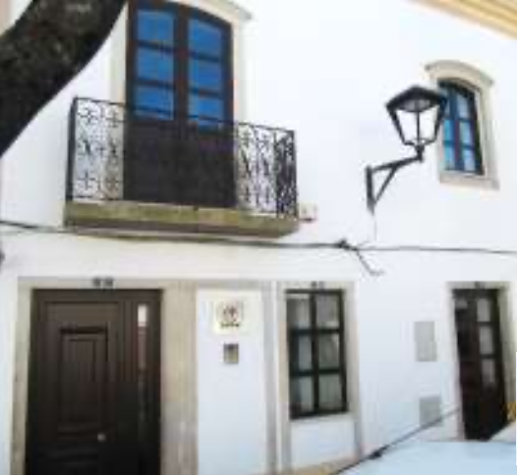
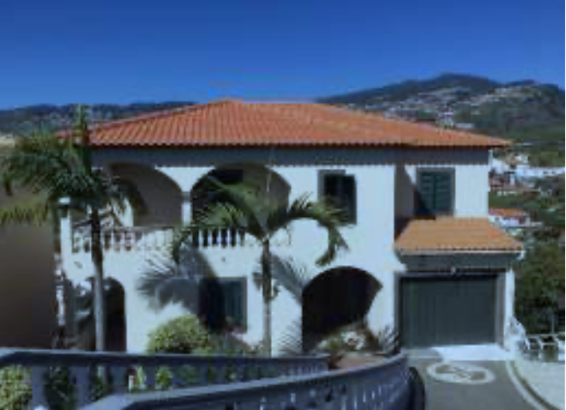
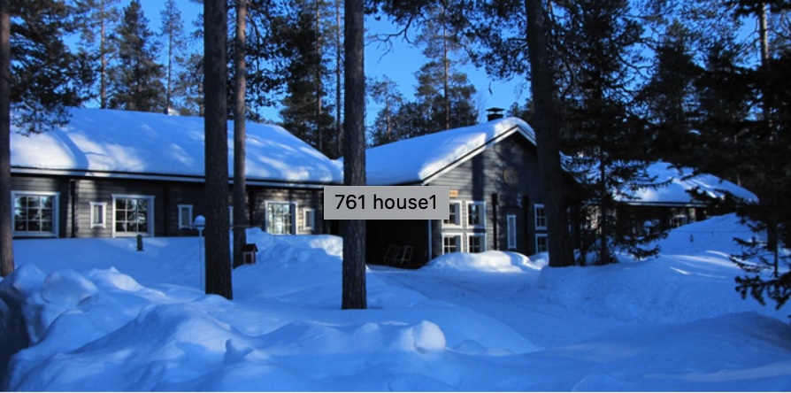
Other Accommodation
Over 390 other properties, hotels etc. offer preferential rates to IPA members, including;
Properties in Cyprus, Spain, Thailand, Japan …

Slide 7
Professional Development
Castle Gimborn – Our flagship educational establishment near Cologne, Germany
Arthur Troop Scholarship - A bursary of €2,500 to attend a police related course or seminar overseas
Lincoln Award – Apply for up to £1000 twice yearly to attend a police related course
YPOS - Annual International Young Police Officers' Seminar
ILDEP - International placements and exchange programme
International ‘On Patrol’ events
Coming in 2024 - UK Based Member Benefit Seminars

Slide 8
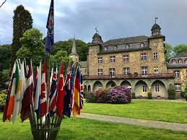
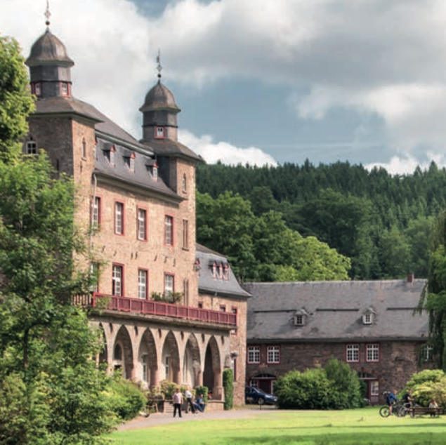
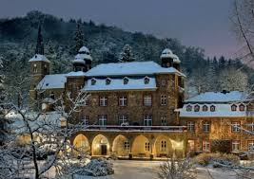

Gimborn really is a castle!

Slide 9
2024 Gimborn Seminars
At Gimborn – Online – Hybrid
Tactical First Aid
Women & Girls as Victims of Violence
OSINT tools in Police Work
The Maintenance of Public Order
Dealing with People in Mental Health Crisis
Police Officers in International Missions
The Challenge of Dealing with Disasters
In addition, your region offers financial
assistance with travel costs

Slide 10

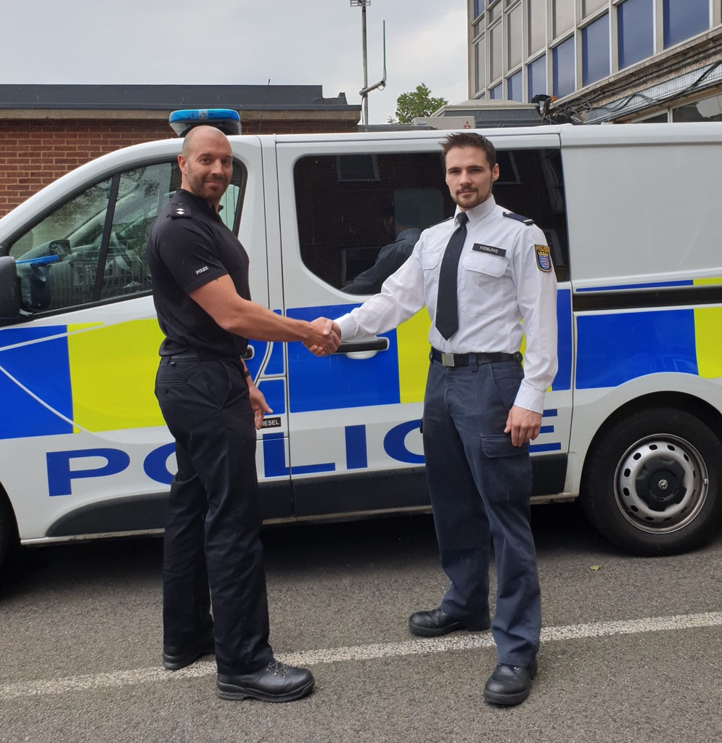
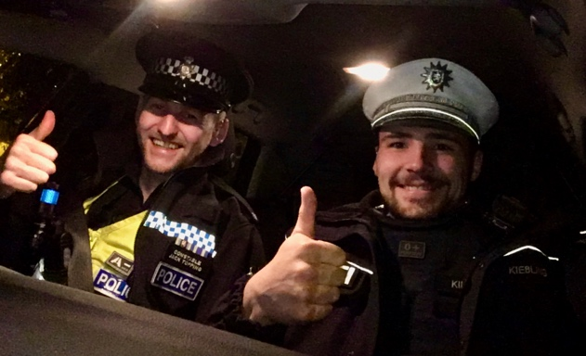
Professional Exchanges
German Officer, Jonas Kiessling’s Internship

Slide 11
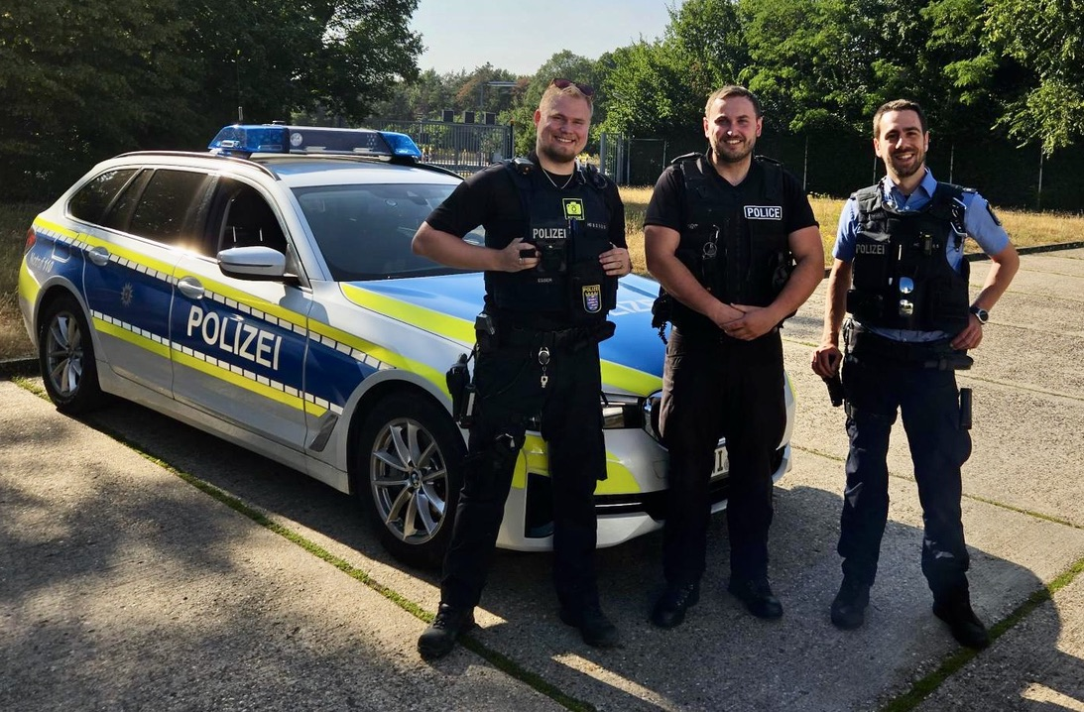
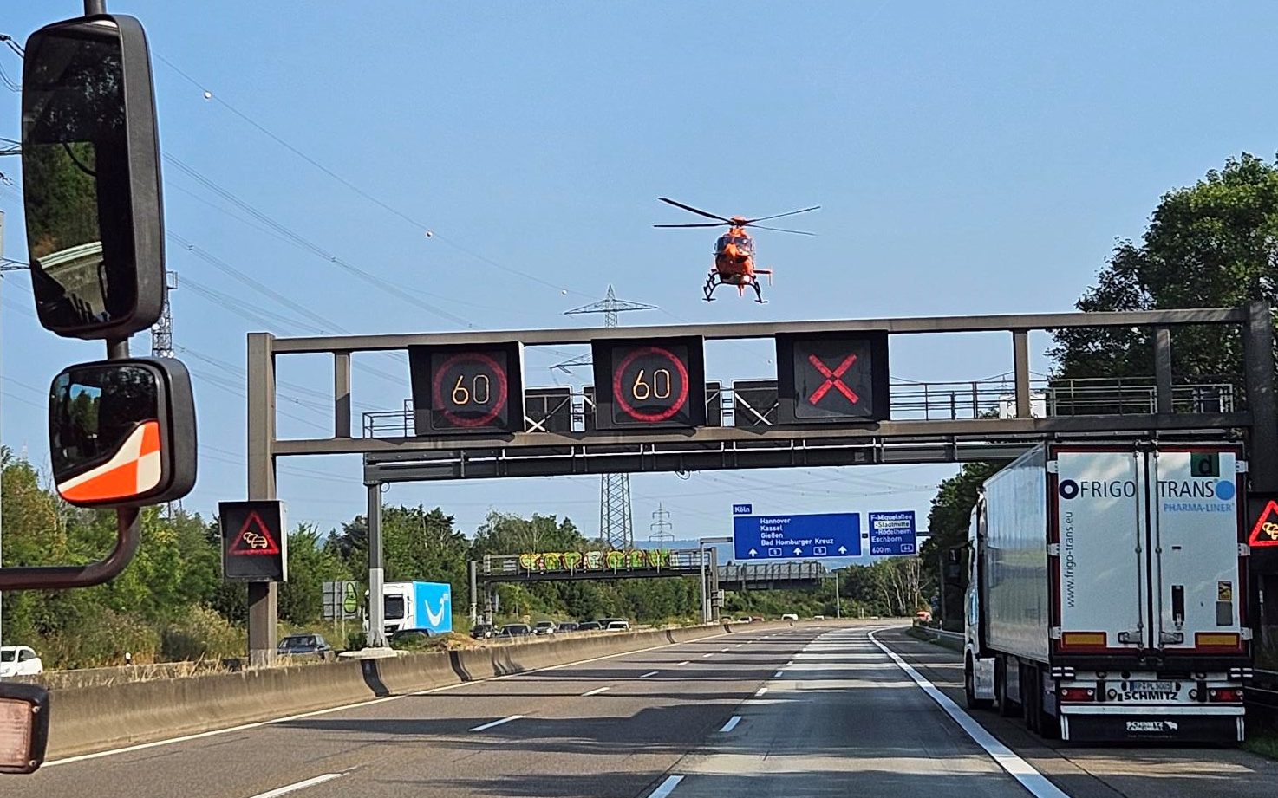
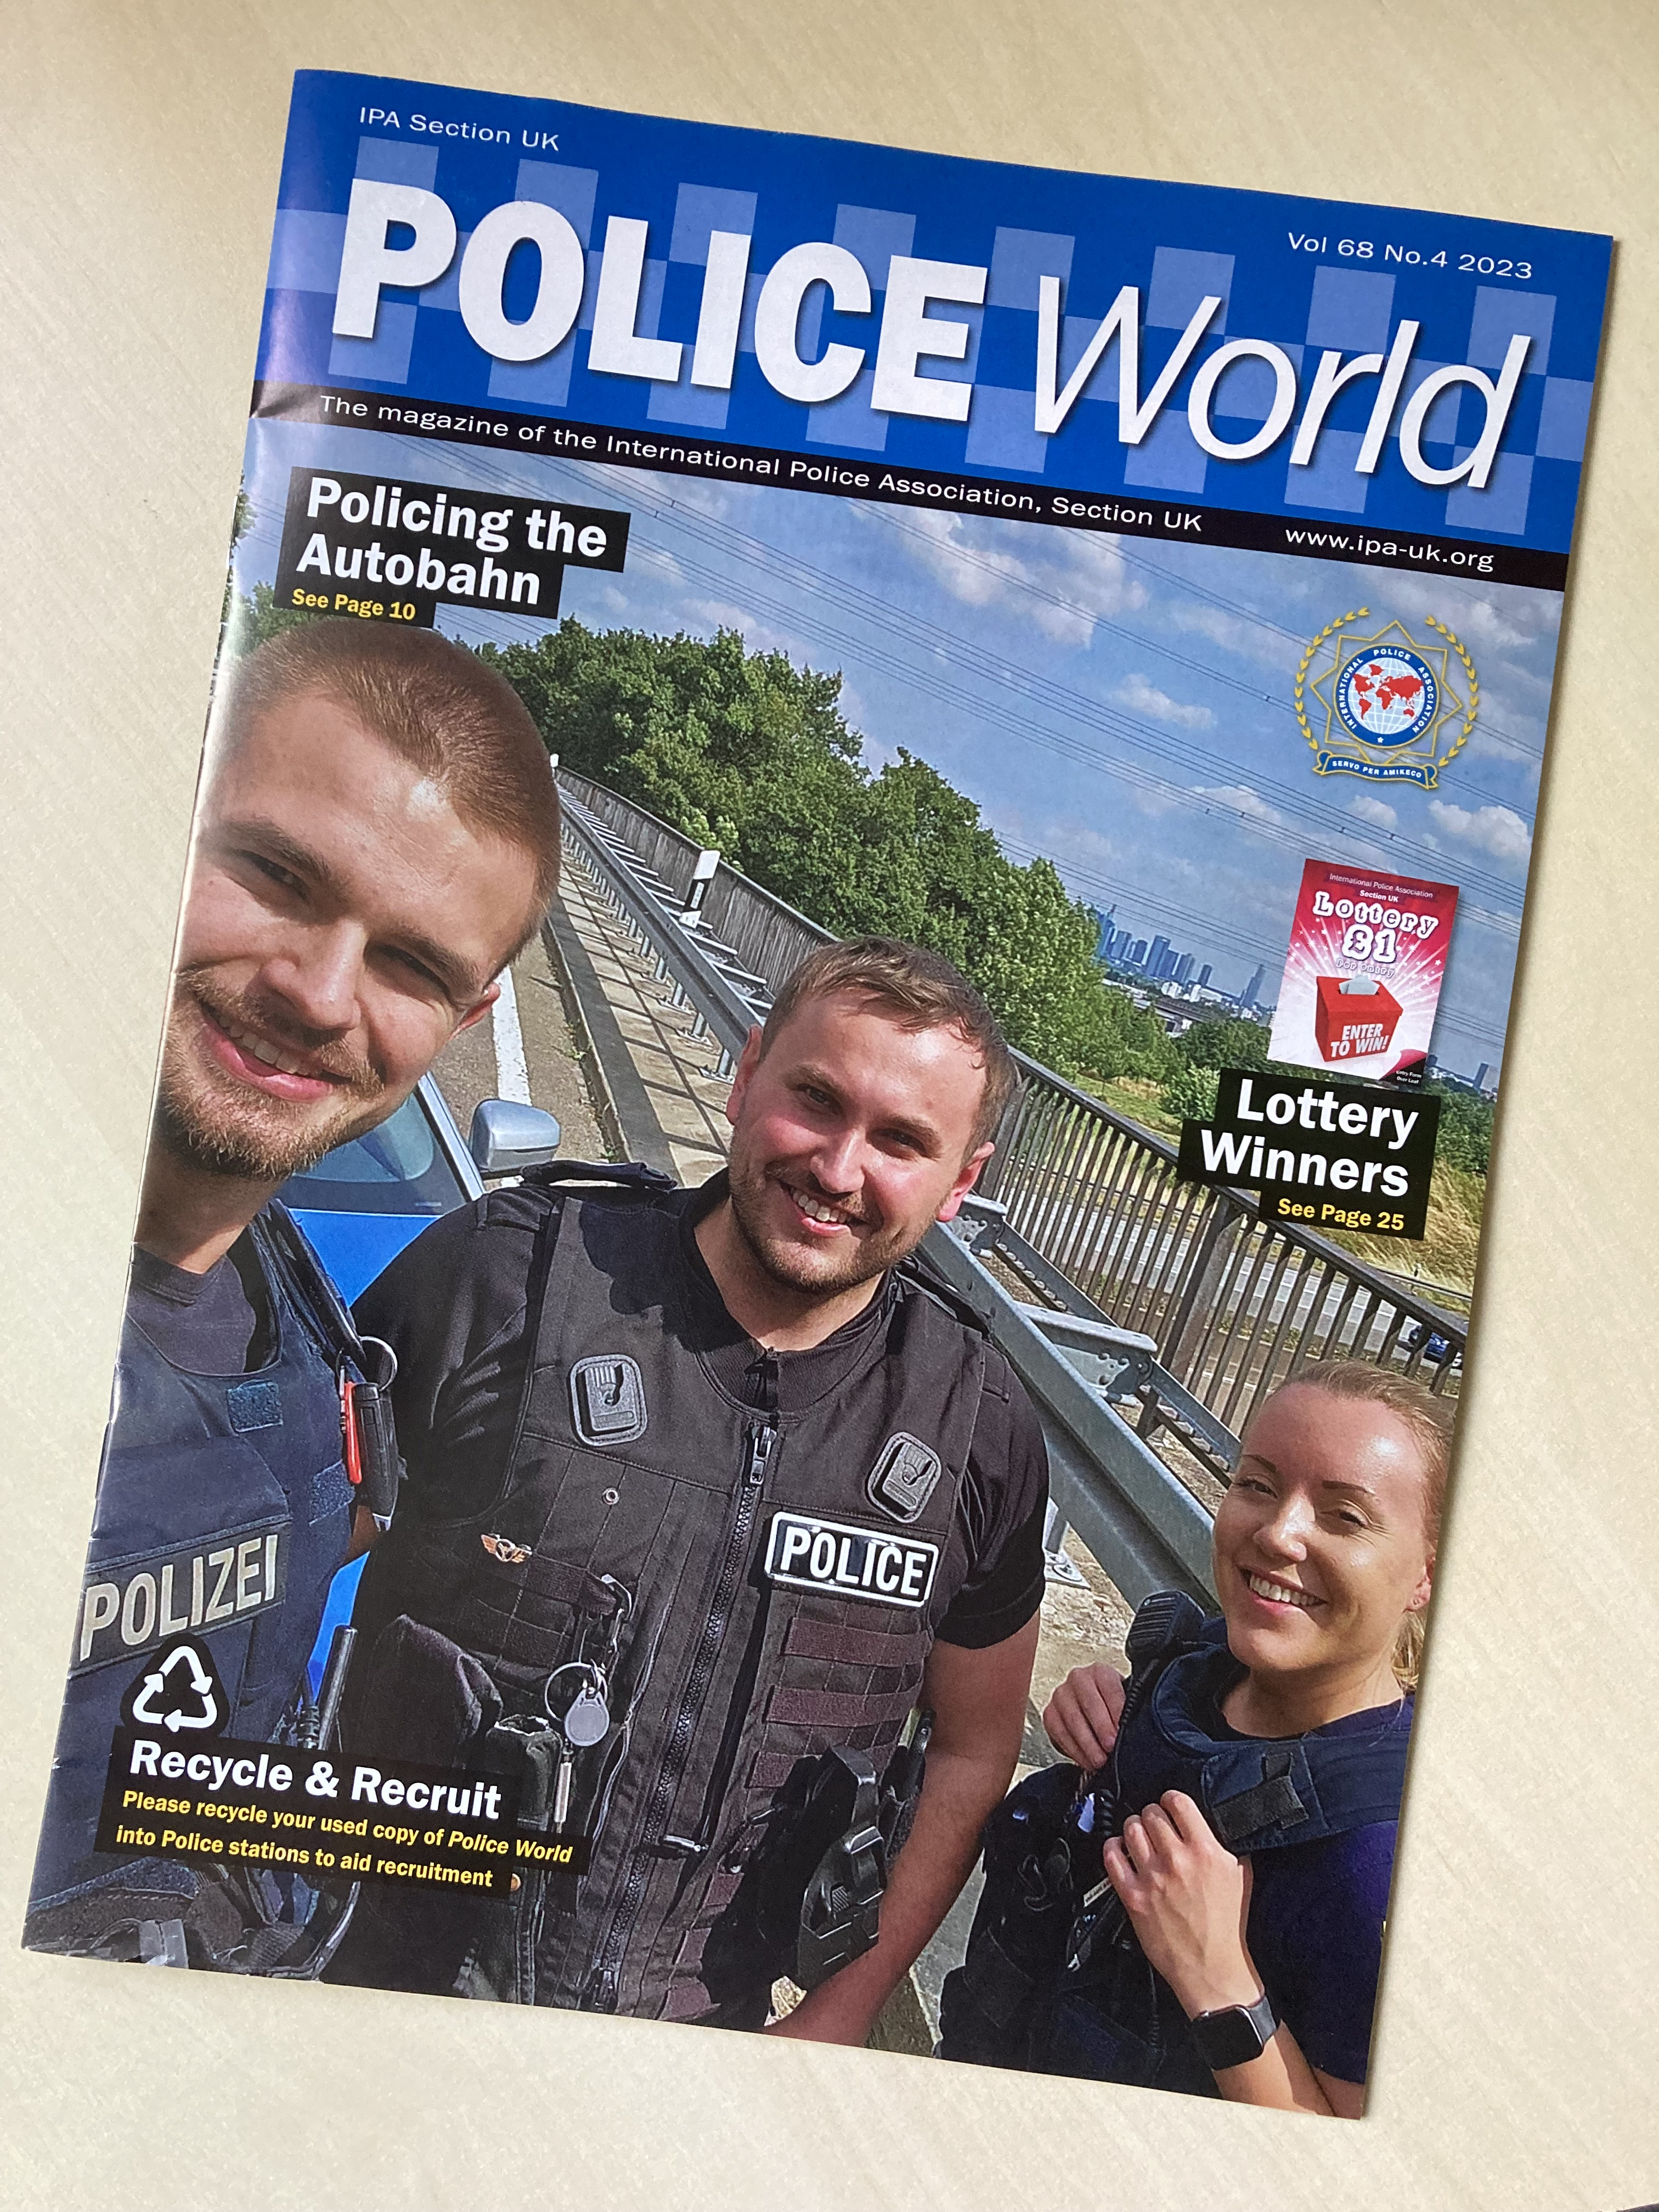
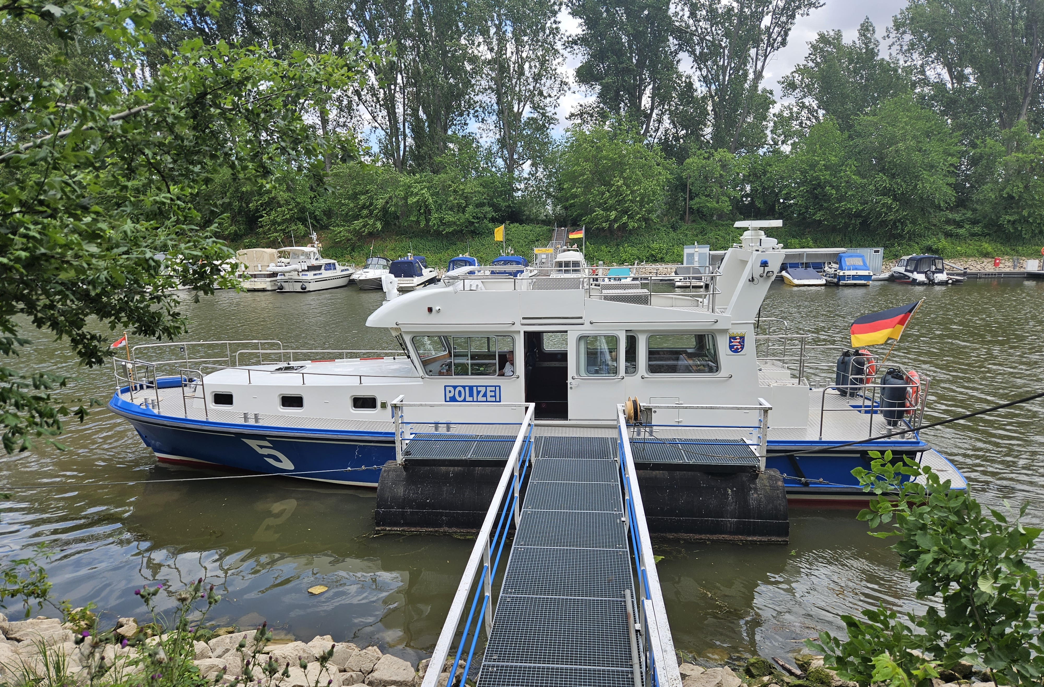
Josh Preston – Norfolk Roads Policing

Slide 12
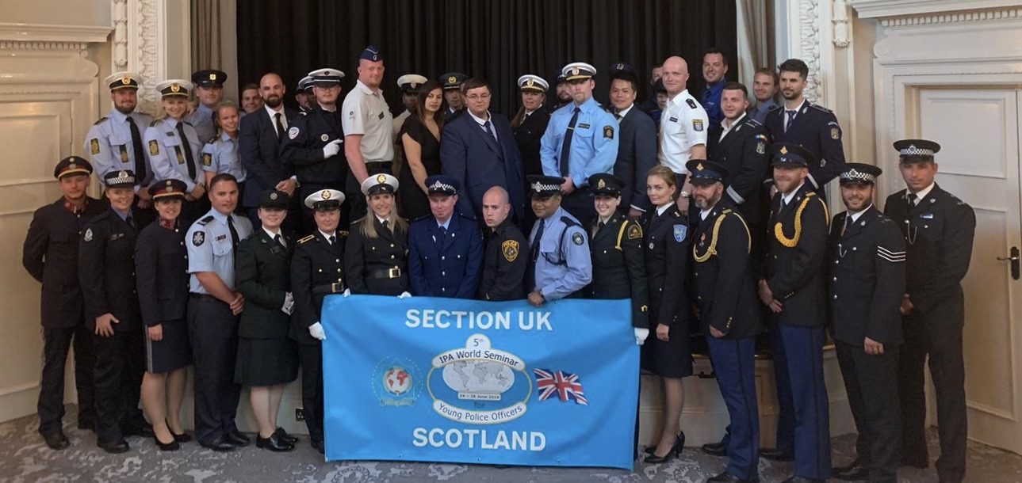
Young Police Officers Seminar
Annual Young Police Officers Seminar
2024 in Austria

Slide 13
Travel Opportunities
IPA Travel Form
Want to break out of the tourist bubble? Submit an IPA Travel Form and see what the IPA can do for you.
Coming soon – Travel Bobby app
Branch Contacts Across Europe
Cambridgeshire Branch members have IPA contacts in Ireland, Germany, Poland, Italy, Austria & Romania.
Help Abroad
Trouble while traveling abroad?
Your IPA Membership could make all the difference.

Slide 14
Local, National & International Events
Friendship Weeks around the world
Cambridgeshire Branch runs a full calendar of events throughout the year
Ceremony of the Keys at HM Tower of London
Use of the Civil Service Club in Whitehall
Other UK branch events publicised weekly
Websites and Facebook
Daily e-Alerts (if you want them)
Quarterly publication – ‘Police World’

Slide 15


Members’ Quarterly Magazine ‘Police World’

Slide 16
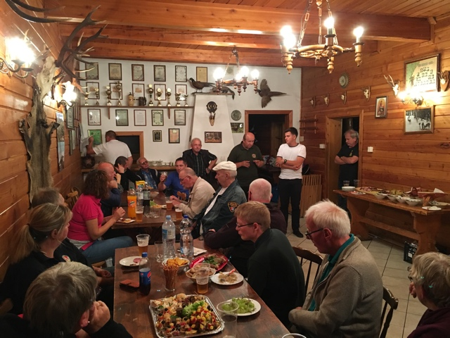
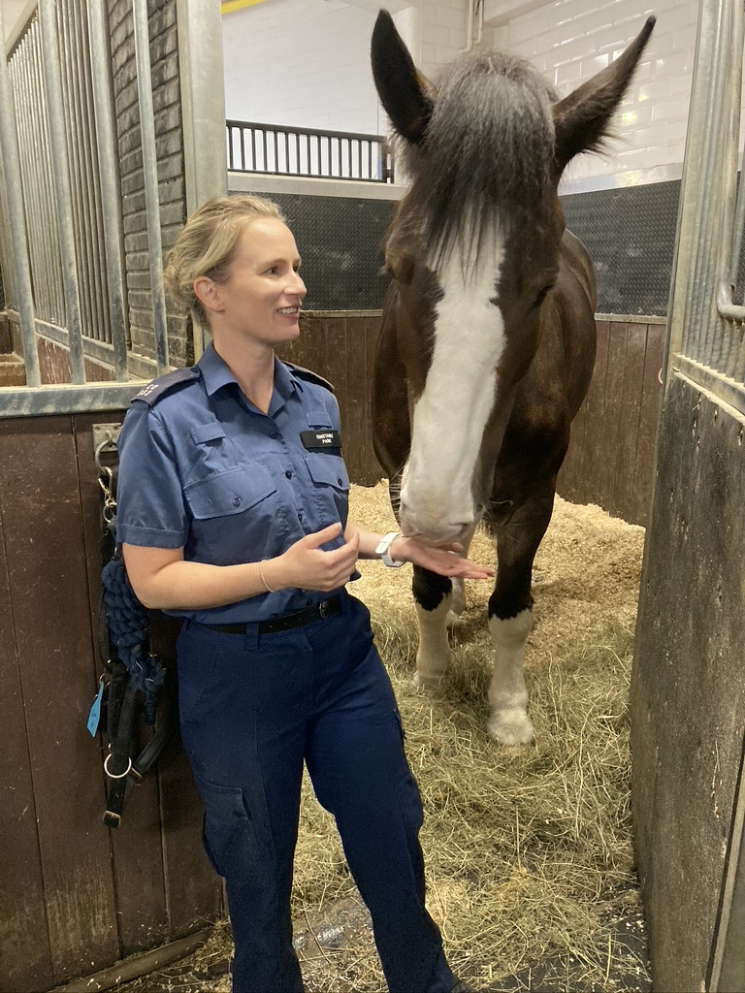
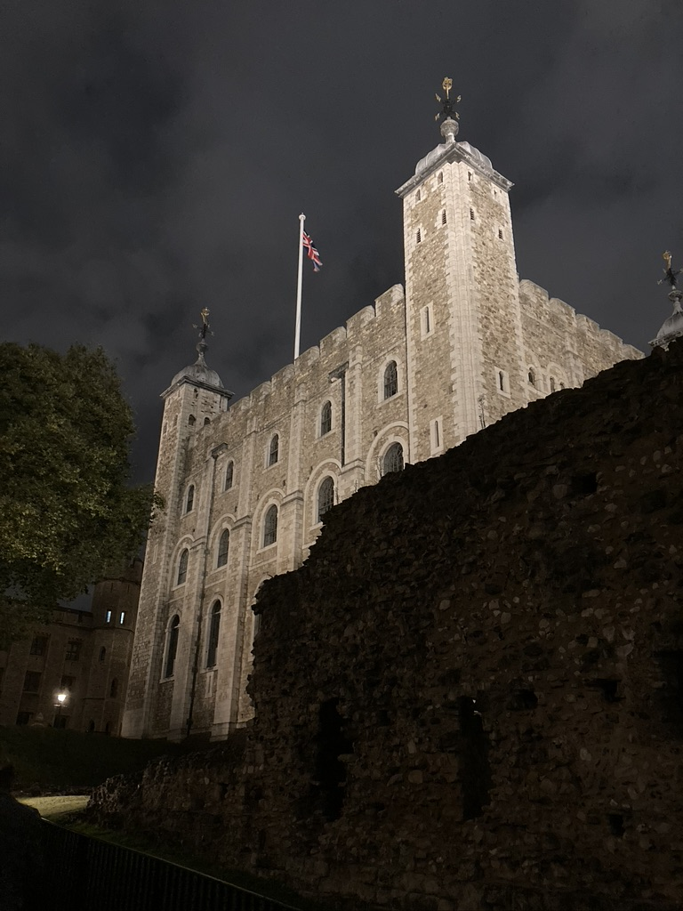
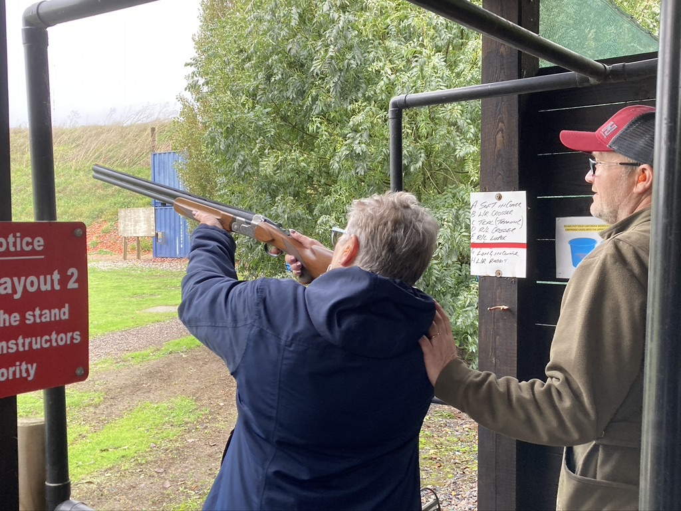
Cambridgeshire Branch Activities
Met Police Stables
September 2023
Friendship Week Poland
September 2024
Clay Shooting
October 2023
HM Tower of London Ceremony of the Keys - Free

Slide 17

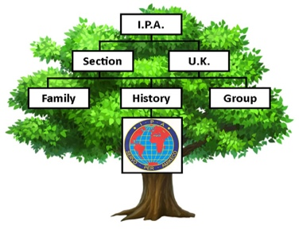


Special Interest Groups
Motorcycle Regular rallies around the UK and Europe
Defensive Tactics Self Defence & Street survival skills
Caravan & Motorhome Full programme of rallies across the UK
Family History Group Help and advice researching your family history
Writers Group Everyone has a book in them…
Walking Group Walking Weekends for the family
Music Group A newly formed group of musicians and music enthusiasts

Slide 18

IPA Lottery
Monthly prize draw, minimum £1 stake.
Apply for course funding to pursue an hobby or interest
whether or not you win!

Slide 19
Enrolment Fees – 2023/2024 offer
January - March = £40
April – June = £30
July – September = £20
October – December = £40*
(*up to 15 months for the price of 12)
‘2 Together’ Offer - Join with a colleague for just £20
at any time of year.
Join from now until 30th June 2024 and be entered into a draw for a 2 night stay at the Civil Service Club in London on Friday 6th and Saturday 7th September 2024.
The annual renewal fee is £33

Slide 20


Find out more …
For more information, please speak to the Monks Wood IPA representative, Claire Beck
IPA Cambridgeshire Branch
www.ipacambs.org.uk
www.ipa-uk.org

Slide 21
Any Questions?
IPA Section UK Proudly Supporting the Thin Blue Line

